Slide 1


NeuGraph: Parallel Deep Neural Network Computation on Large Graphs
USENIX ATC ’19, Renton, WA, USA
Lingxiao Ma †, Zhi Yang †, Youshan Miao ‡, Jilong Xue ‡, Ming Wu ‡, Lidong Zhou ‡, Yafei Dai †
† Peking University
‡ Microsoft Research
Notes:
Hello, everyone. I am Lingxiao Ma from Peking University in China.
Today, I will talk about our work. NeuGraph: Parallel Deep Neural Network Computation on Large Graphs.
This is a joint work with Microsoft Research.

Slide 2
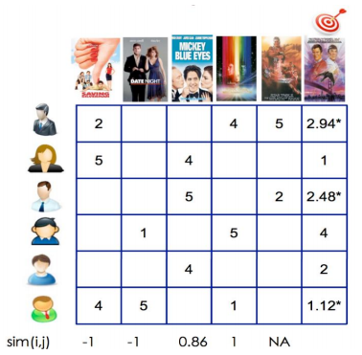
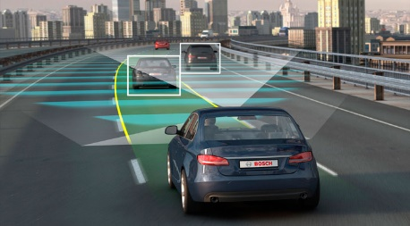


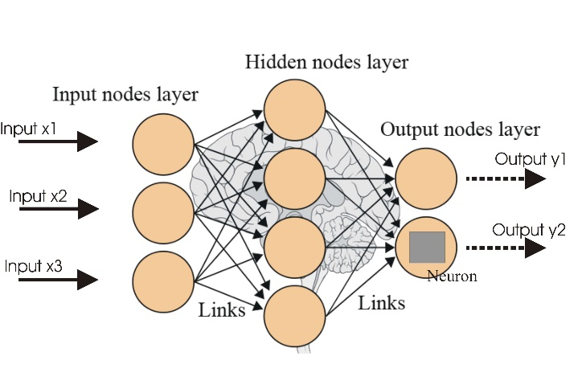
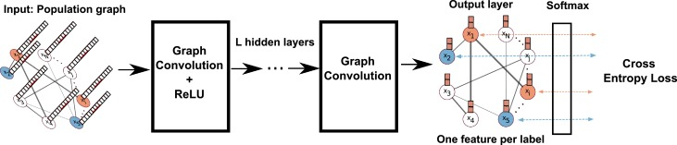
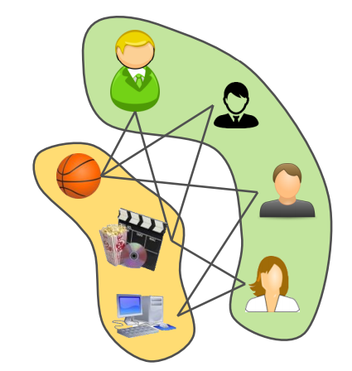
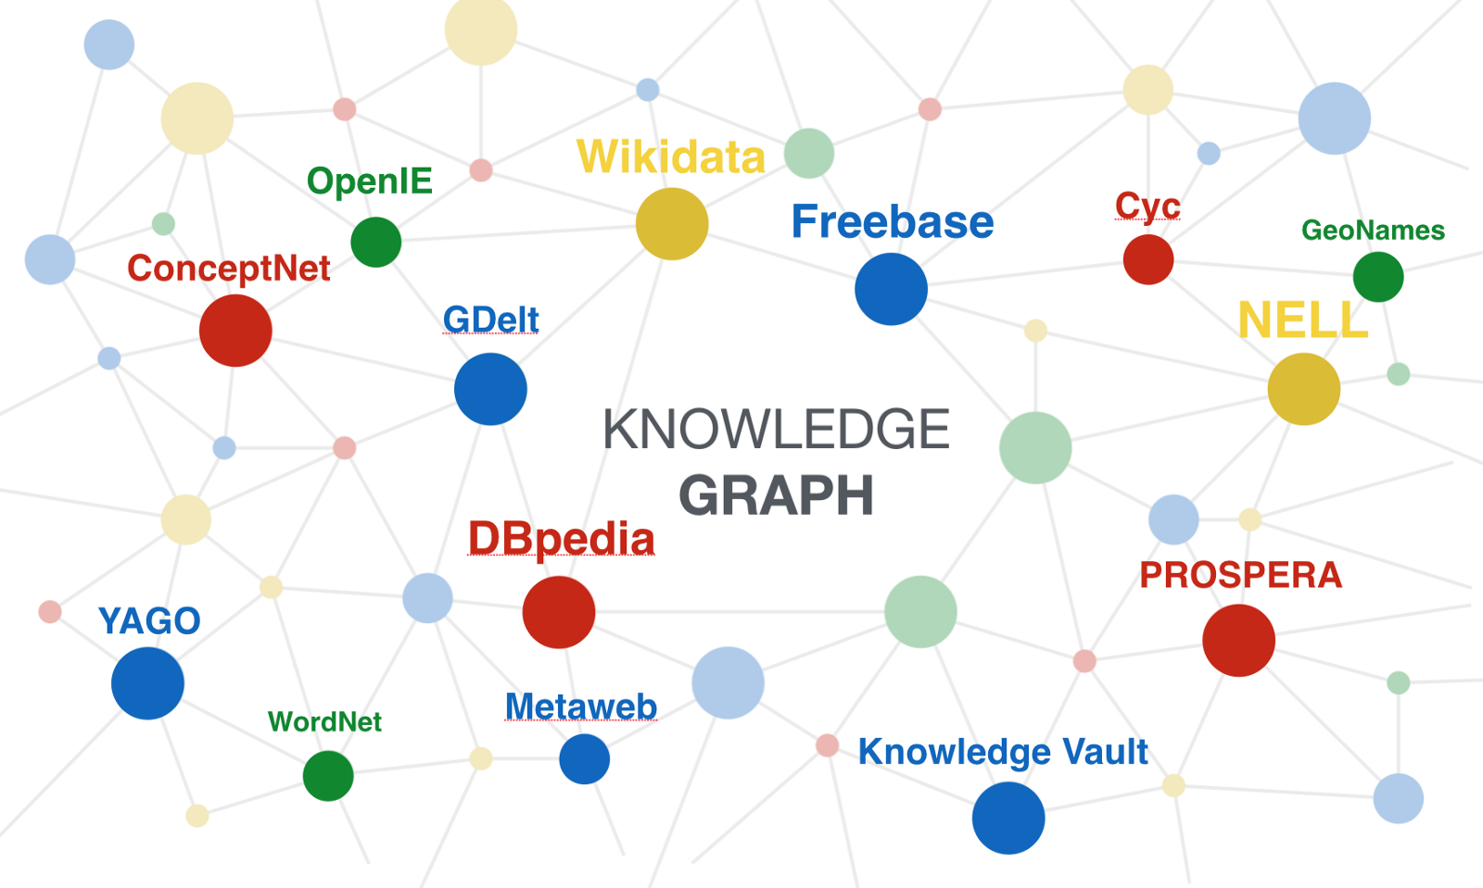
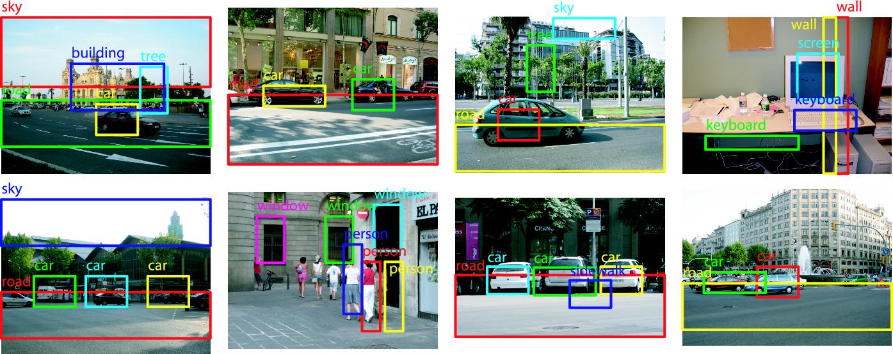

* Figures from Internet
Self-Driving
Personal Assistant
Recommendation
Question Answering
Input Feature Vector
Input: Graph Data
Neural Networks
Graph Neural Networks
Image Object Detection
Speech Recognition
User-Item Graph
Knowledge Graph
Notes:
Deep neural networks
(click)
have achieved great successes in many areas.
(click)
Recently, there is an emerging trend in applying deep learning on graphs, known as graph neural networks.
(click)
And they have achieved convincing model accuracy in many real-world applications.
For example, it can learn features from the user-item graph for higher-quality recommendation.
(click, next slide)

Slide 3
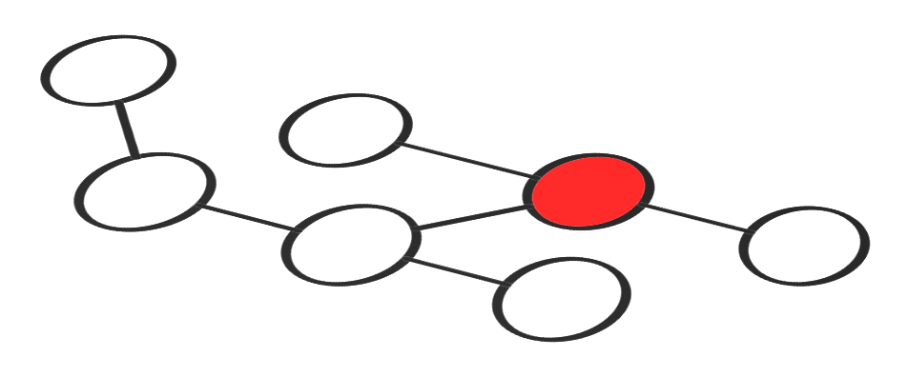
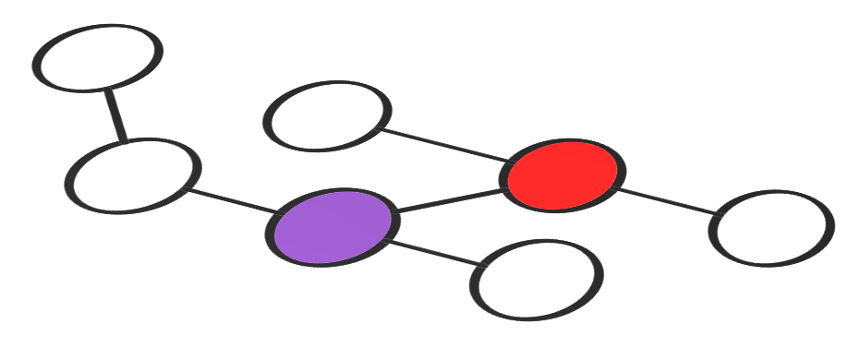
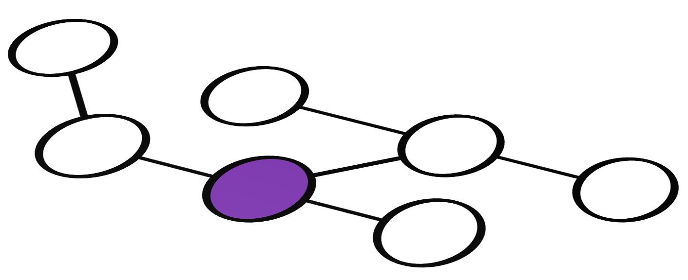

Graph Neural Networks (GNN)
Information propagation via Graph
Information transformation via Neural Networks
Notes:
GNNs aggregate information following the graph structure.
(click)
Specifically, each vertex or edge in the graph is associated with a set of data as its features.
(click)
A GNN can consist of multiple layers
(click, next slide)

Slide 4
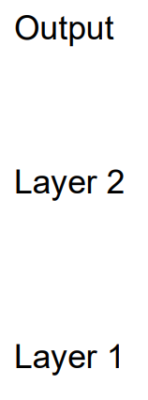
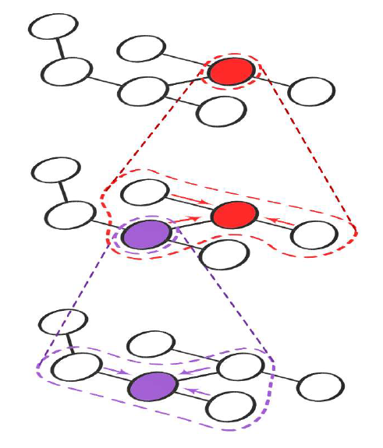
Graph Neural Networks (GNN)
Information propagation via Graph
Information transformation via Neural Networks
EdgeNN Transformation
VertexNN Transformation
Notes:
with iterative propagating layer-by-layer over the same graph.
(click)
At each layer, the vertex or edge features are transformed and propagated along edges, and then aggregated at the target vertices to produce new features for the next layer.
(click, next slide)

Slide 5
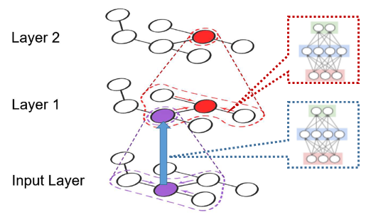
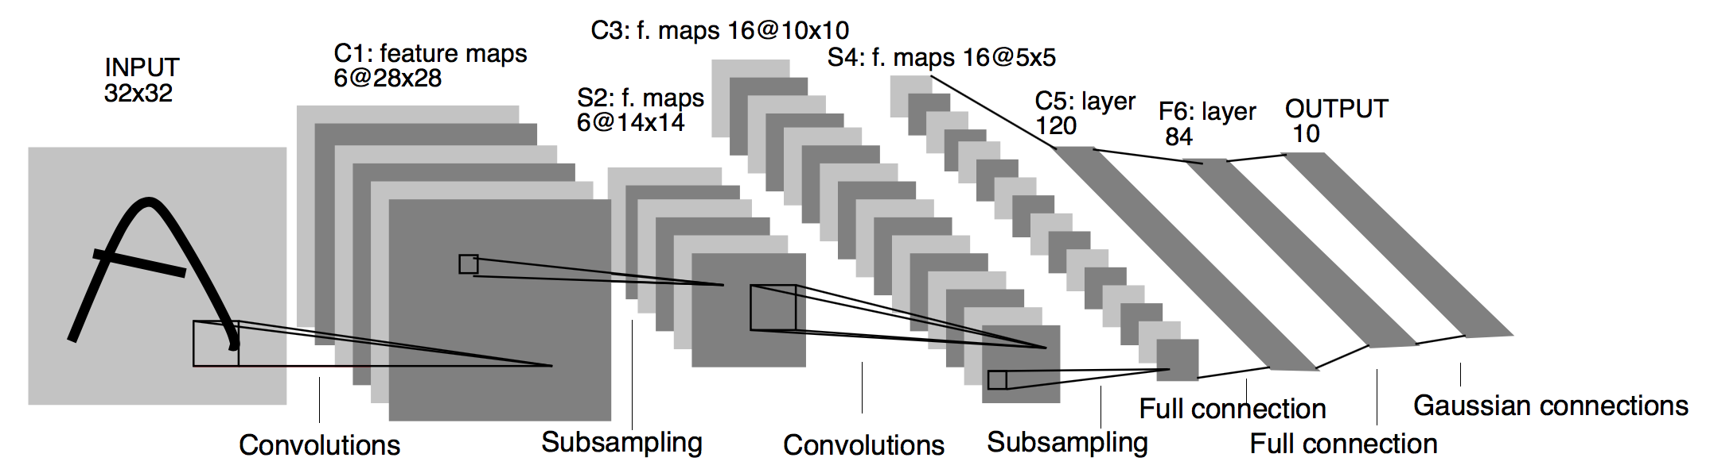
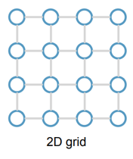
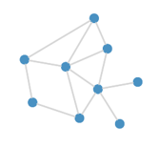
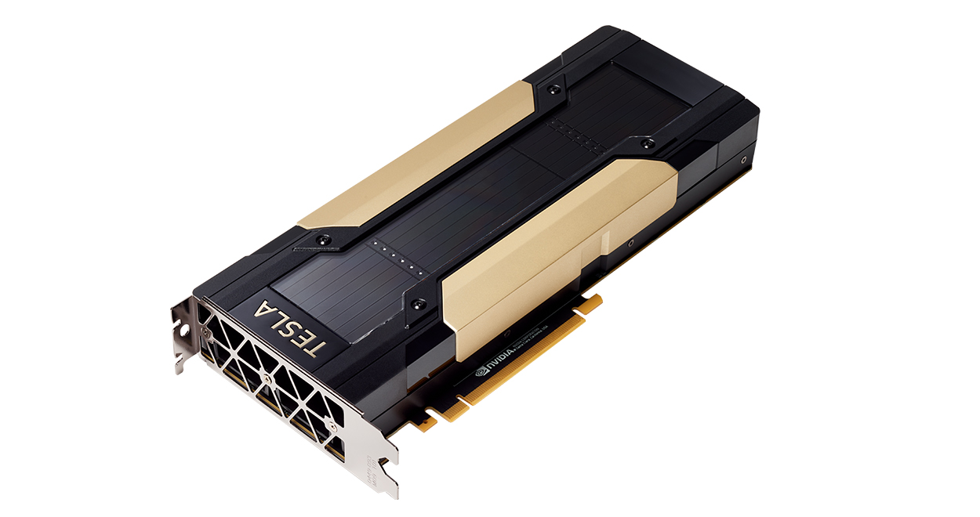


Challenges in Processing GNNs on GPU
* Figures from Internet
small and regular
large, sparse, and irregular
Graphs
Scalability Problem
Efficiency Problem
Notes:
Traditional DNNs have small and regular grid structures,
(click)
which is friendly to GPUs.
(click)
However, in GNNs, graphs are large, sparse, and irregular,
(click)
resulting in scalability and efficiency problems.
(click, next slide)

Slide 6



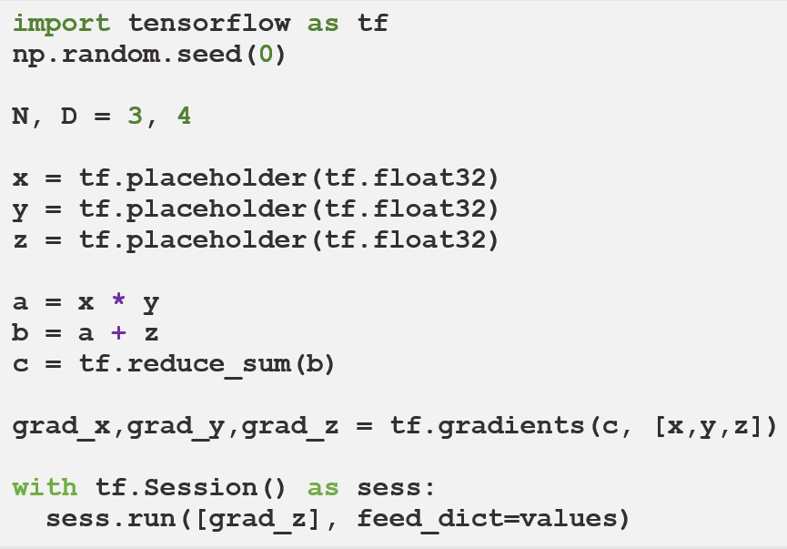

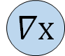
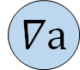
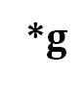
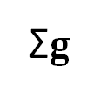
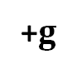
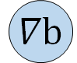
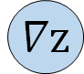
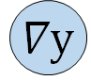
Existing Systems are Insufficient
Deep Learning Systems
x
y
z
$$∇x$$
$$∇y$$
*
*$g$
$$∇z$$
Dataflow Graph
as
Intermediate Representation
a
$$∇a$$
+
+$g$
b
$$∇b$$
easy to express NNs
efficient for grid structures
Σ
Σ$g$
hard to express graph ops
hard to handle large graphs
c
Notes:
There are many deep learning systems for neural network processing. Here is a simple example to describe how deep learning systems run.
(click)
First, we declare several placeholders for input data.
(click)
Then, we declare the forward computation logics with operators.
(click)
Deep learning frameworks can automatically generate the backward computation to compute the gradients.
(click)
With these code, we construct a graph called dataflow graph as the intermediate representation in deep learning training.
(click)
The dataflow abstraction is easy to express neural networks and efficient for neural network execution.
(click)
However, it’s hard to express graph operations and handle large graphs because it takes the whole graph as a data tensor without graph-awareness.
Most recently, deep graph library warps deep learning systems as graph interfaces for GNN programming. However, it has the same scalability and efficiency problems, because the backend works as usual without graph-awareness.
(click, next slide)

Slide 7

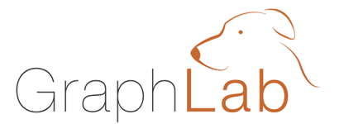
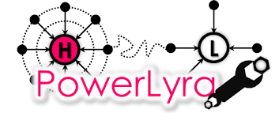

Existing Systems are Insufficient
Graph Computing Systems
Vertex Programming
e.g.: GAS
Gather(D_{u}, D_{(u,v)}, D_{v}):
return D_{v}.rank / #outNbrs(v)
Sum(a, b):
return a + b
Apply(D_{u}, acc):
r_{new} = 0.15 + 0.85 * acc
D_{u}.delta = (r_{new} - D_{u}.rank) / #outNbrs(u)
D_{u}.rank = r_{new}
easy to program graph apps
graph-aware optimizations
scale to trillion edges
Scatter(D_{u}, D_{(u,v)}, D_{v}):
if(|D_{u}.delta|>ε) Activate(v)
return delta
hard to express NNs (e.g., no backprop.)
insufficient NN execution (e.g., vertex-by-vertex)
7
Notes:
There are also many graph engines for large-scale graph computing. Take PowerGraph as an example to describe how graph engines run.
(click)
First, we define the Gather function to describe how a vertex get information from its in neighbors.
(click)
Then, the Apply function is used to update itself with Gathered information.
(click)
Finally, the vertex sends messages to the out neighbors with the Scatter function.
(click)
The whole procedure is defined in a vertex view, called vertex programming. And engines can know each vertex’s manner.
(click)
Thus, it is easy to use the graph model to program graph applications, apply graph optimizations and scale to very large graphs.
(click)
However, these systems are hard to express neural networks and insufficient for neural network execution due to the lack of dataflow abstraction.
(click, next slide)

Slide 8
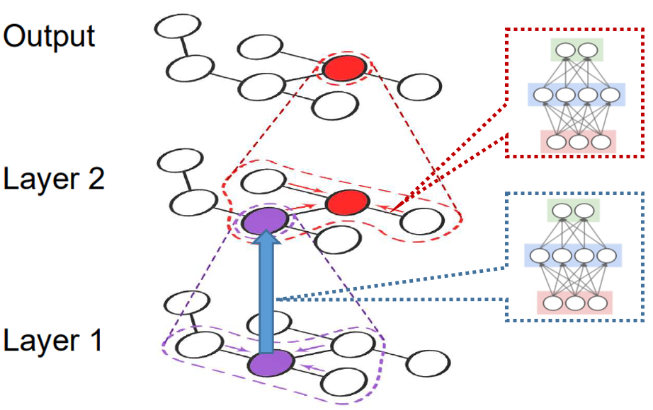
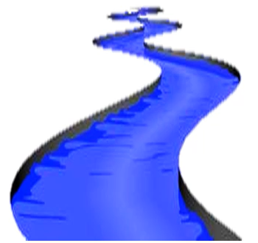
We propose: NeuGraph
Bridge graph and dataflow models to support efficient and scalable GNN processing
NeuGraph
easy to program graph apps
graph-aware optimizations
scale to trillion edges
easy to express NNs
efficient for grid structures
Deep Learning Systems
Graph Systems
Notes:
We propose NeuGraph, which bridges graph and dataflow models to learn wisdom and benefit from both to support efficient and scalable GNN processing
(click, next slide)

Slide 9
NeuGraph
Bridge graph and dataflow models to support efficient and scalable GNN processing
Key techniques
SAGA-NN model for graph-based neural networks
-> programming GNN apps
Chunk-based dataflow graph translation & streaming processing out of GPU core
-> processing graphs larger than GPU memory
Highly-optimized graph propagation operators
Chain-based parallel streaming
-> efficient multi-GPU parallel execution
Performance
Outperform state-of-the-art frameworks (e.g., TensorFlow and DGL) on small graphs
Scale to large real-world graphs with GPUs
Notes:
It contains a SAGA-NN model for programming GNN applications.
(click)
Chunk-based dataflow graph translation and streaming processing out of GPU core to support large graphs.
(click)
We also designed highly-optimized graph operators for graph propagation.
(click)
And chain-based parallel streaming strategy for efficient multi-GPU execution.
(click)
With these techniques, NeuGraph outperforms state-of-the-art implementations on small graphs fit into GPU memory,
(click)
and scales to large graphs with GPUs.
(click, next slide)

Slide 10
SAGA-NN Abstraction
V₀
V₁
V₂
EdgeNN
Transformation
Notes:
First, let’s talk about the SAGA-NN abstraction. There are four stages in SAGA-NN.
(click)
First, the Scatter propagates information from vertex to the edge to prepare data for the edge transformation.
(click)
Then, the ApplyEdge represents the neural network computation on the edge to transform the edge data.
(click)
Then, the transformed edge data are Gathered to the destination vertex.
(click, next slide)

Slide 11
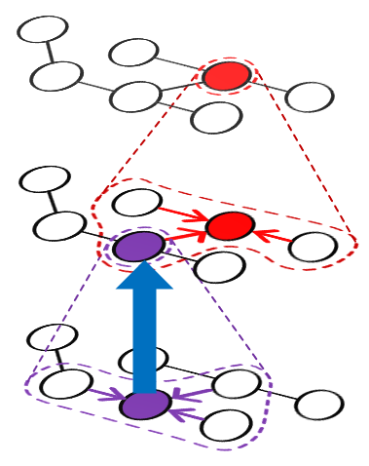
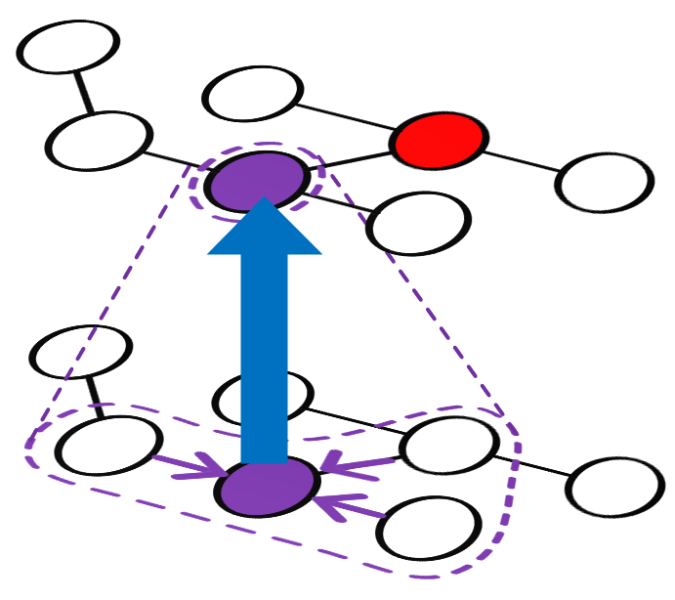
SAGA-NN Abstraction
VertexNN
Transformation
V₀
V₁
V₂
EdgeNN
Transformation
Notes:
Finally, the ApplyVertex represents the neural network computation on the vertex to transform the output of the Gather stage.
Those four stages define a layer of GNN.
(click)
And users can define multiple GNN layers.
(click, next slide)

Slide 12
SAGA-NN Abstraction
Graph Operations
transparent to users
Neural Network Operations
define NN computation with dataflow
Notes:
In SAGA-NN, Scatter and Gather are graph operations, which are transparent to users.
(click)
ApplyEdge and ApplyVertex are neural network operations where users define neural network computation with dataflow.
(click, next slide)

Slide 13
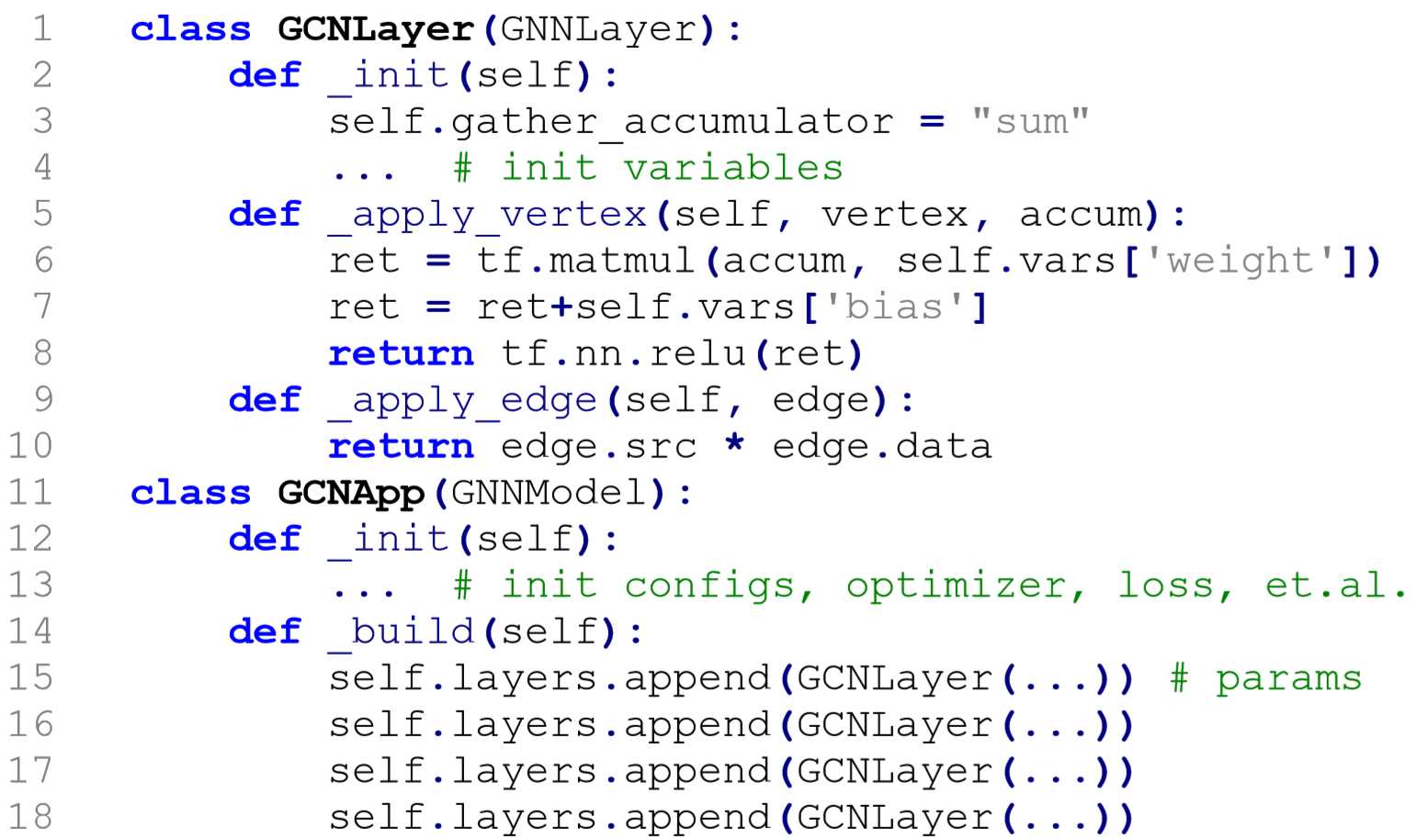
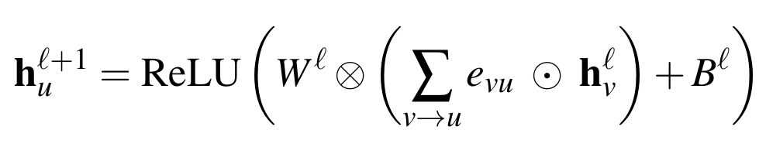
Example: Graph Convolutional Network (GCN)
Gather
Scatter
ApplyEdge
ApplyVertex
Notes:
Here is an example to describe how to map graph convolutional network to SAGA-NN
(click)
In GCN, information from neighbors are multiplied with the scalar value on the edges. So we implement a multiply operator in the ApplyEdge.
(click)
And set the accumulator as sum to sum up neighbors’ information.
(click)
Then GCN has a fully-connected neural network on the vertex, so we implement it in the ApplyVertex.
These code represent a layer of GCN.
(click)
We can implement multiple layers of GCN by stacking it layer-by-layer.
(click, next slide)

Slide 14
Scaling beyond GPU memory limit
Graph partition
GPU
(16GB Memory)
Notes:
In each layer of GNN,
(click)
the vertex features and edges from the previous layer
(click)
are used to compute the new vertex features.
However, most real-world graphs are large and cannot fit into GPU memory.
(click)
Thanks to the graph model in SAGA-NN, we can leverage graph partition to scale to large graphs.
NeuGraph carefully combines graph partition with dataflow to solve the scalability problem in GNN.
(click, next slide)

Slide 15
Scaling beyond GPU memory limit
Accumulate in GPU memory
2D graph partitioning
GPU
(16GB Memory)
column-by-column
chunk scheduling
Notes:
Specifically, we leverage the 2D graph partition. The vertices and edges are partitioned into chunks.
(click)
For example, to compute the new vertex chunk v0’ which contains vertex 0 and 3, it needs to gather information from neighbor vertex 0, 1 and 3 in chunk E00 and E10.
(click)
Then, we can process the graph chunk-by-chunk in the limited GPU memory.
There is a scheduling problem. We can consume chunks row-by-row, or column-by-column, or any other order.
(click)
We observe that the intermediate data can be accumulated in GPU memory to reduce host-device communication.
(click)
Thus, we take the column-by-column scheduling policy.
(click, next slide)

Slide 16
Chunk-based Dataflow Translation: GCN
Notes:
With graph partition, NeuGraph translates the SAGA-NN program to a chunk-based dataflow graph. Take GCN as the example. To compute the chunk V0’, we need to calculate chunk V0 E00 and chunk V1 E10.
(click)
With the column-by-column scheduling policy, we first calculate E00 with Scatter-ApplyEdge-Gather and output the accum of this chunk.
(click)
Specifically, as GCN only has a multiply operation for source vertex and edge, we connect a multiply operator between Scatter and Gather. Thus, the source vertex data in V0 are multiplied with edge value in E00 and gathered to output an accum.
(click)
And it does the same manner for chunk E10.
(click)
After that, the neighbors’ information have been collected at the destination vertices. Then the ApplyVertex function is used to transform the collected data and output the V0’. And V1’ can be computed in a similar manner.
Thus, we get a chunk-based dataflow graph for the forward computation logics, and the backward computation can be generated by auto-differentiation.
(click, next slide)

Slide 17
Scaling to multi-GPU
Naïve solution:
Approach: each GPU takes a “column” of edge chunks
Problem: redundant data transfer through shared upper links
bandwidth
bottleneck
GPU0
GPU1
GPU2
GPU3
Notes:
OK, next.
As graphs are usually large, we would like to scale GNN to multiple GPUs for faster processing.
(click)
A naïve solution is to let each GPU take a column of edge chunks and output the related vertex chunk.
(click)
However, the PCIe lanes are limited in modern servers. So the PCIe switch is introduced to support more GPUs in one server.
(click)
Because each GPU will take all the input vertex chunks.
(click)
The redundant data transfer through shared upper links results in bandwidth bottleneck.
(click, next slide)

Slide 18
Scaling to multi-GPU
Observation: link to neighbor GPU is empty
Approach: directly load from neighbor GPU
GPU-to-GPU
GPU0
GPU1
GPU2
GPU3
Notes:
We observe that the links to neighbor GPUs within the same PCIe switch are empty. And each GPU will load the same data.
(click)
So we can let GPU directly load data from its neighbor GPU via GPU P2P communication, which reduces the data transfer on the shared upper link.
(click, next slide)

Slide 19
Scaling to multi-GPU
Observation: link to neighbor GPU is empty
Approach: directly load from neighbor GPU
GPU0
GPU1
GPU2
GPU3
Notes:
Therefore, we formulate GPUs within the same PCIe switch as a chain to collaborate on GNN processing.
(click, next slide)

Slide 20
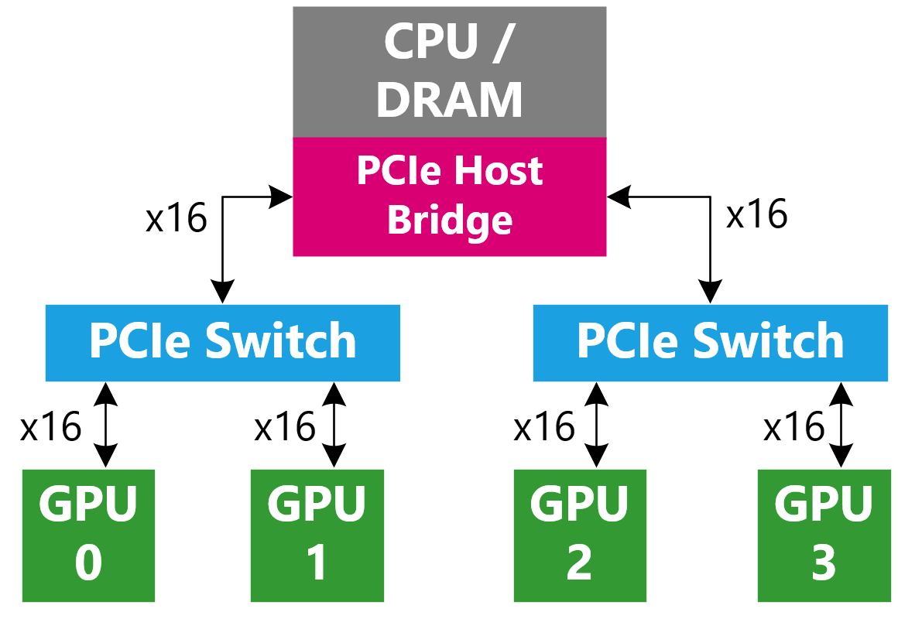

Chain-based Parallel Streaming
Each GPU can consume all the chunks in chain for a PCIe switch
GPU0
GPU1
GPU2
GPU3
Notes:
Here is an example.
(click)
First, the leftmost GPU 0 and 2 in each PCIe switch load chunk v1 from the host memory.
(click)
Then, GPU1 load chunk v1 from GPU0 and GPU3 load chunk v1 from GPU2. Meanwhile, GPU 0 and 2 load chunk v2 from the host memory.
(click)
Then, GPU 1 and 3 delete the consumed chunk v0 and load chunk v1 from GPU 0 and 2. Meanwhile, GPU 0 and 2 load chunk v3 from the host memory.
(click)
Then, these GPUs do the same manner for next chunks.
This procedure describes the chain-based parallel streaming on multiple GPUs.
(click, next slide)

Slide 21
High performance graph propagation kernels
Traditional multithread parallelization
PageRank, SSSP, CC, etc: one-dimension scalar value on vertices
A thread takes a vertex/edge
Thread 0
Thread 1
diff ops. on diff vertices
inefficient in GPU(SIMD)
Notes:
Finally, let’s talk about the kernel optimizations in NeuGraph.
Traditional graph algorithms like pagerank usually have scalars on vertices or edges.
(click)
So graph engines make parallelism over vertices or edges, resulting in different instructions on different threads, which is not efficient for GPU.
(click, next slide)

Slide 22
High performance graph propagation kernels
Observation
High-dimension feature
More-regular operations along feature-dimension
Solution: exploit feature-dimension parallelization in GNNs
same ops.
efficient in GPU(SIMD)
Thread 0
Thread 1
Thread 2
Thread 3
Notes:
GNNs usually have regular high-dimension features on vertices or edges.
(click)
So we exploit parallelism on feature-dimension to achieve same instructions over threads, which is efficient to GPU.
(click, next slide)

Slide 23
Experiment Setup
Typical GNN Applications
Communication neural network (CommNet)
// no computation in ApplyEdge
Graph convolutional networks (GCN)
// element-wise Mul in ApplyEdge
Gated graph neural networks (GG-NN)
// GRU in ApplyVertex
Testbed
2x E5-2690-v4 (14-core with HT)
512GB Quad-Channel RAM
8x NVIDIA Tesla P100 GPU
Ubuntu 16.04
CUDA 9.0 + cuDNN 7
dataset | vertex | edge | feature | label | degree | type
blog | 10.3K | 668.0K | 128 | 39 | 65 | social
pubmed | 19.7K | 108.4K | 500 | 3 | 5 | cite
reddit_small | 58.2K | 1.4M | 300 | 41 | 25 | social
reddit_full | 2.4M | 705.9M | 300 | 50 | 292 | social
enwiki | 3.6M | 276.1M | 300 | 12 | 77 | knowledge
amazon | 8.6M | 231.6M | 96 | 22 | 27 | review
Comparison
TF: TensorFlow v1.7 (CPU/GPU)
DGL: Deep Graph Library v0.1.3 with PyTorch v1.0 backend
TF-SAGA: SAGA-NN with TensorFlow v1.7 backend
NG: NeuGraph on top of TensorFlow v1.7
Notes:
Ok, the evaluation.
We implemented NeuGraph on top of TensorFlow and compare it with TensorFlow and deep graph library. We also implemented TF-SAGA without any optimizations to show the superiority of graph optimizations.
We do experiments on a server equipped with 8 GPUs. We use three typical GNN applications on three small and three large datasets.
(click, next slide)

Slide 24
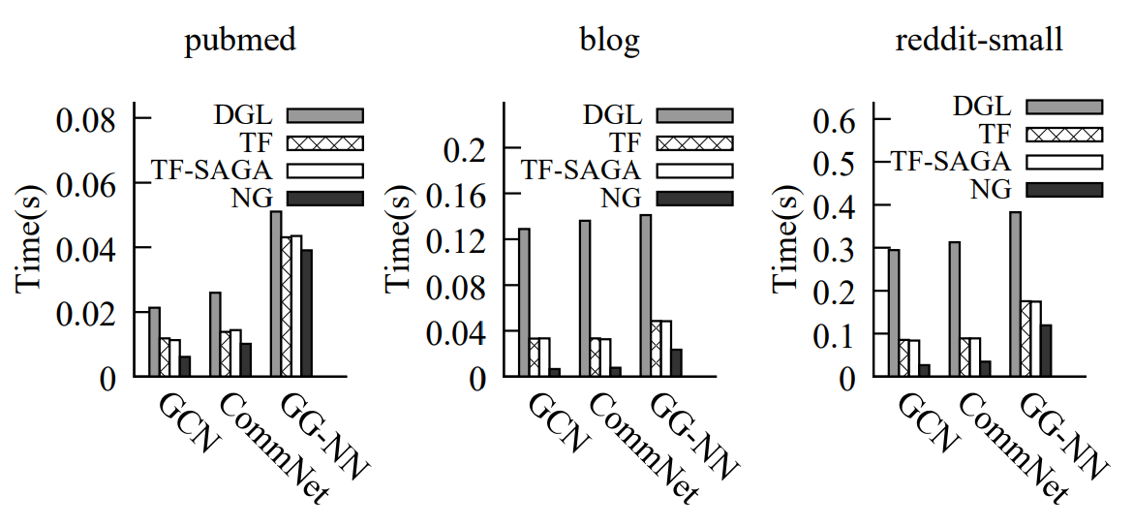
Performance on a Single GPU
Compare with TF, DGL on small graphs
up to 5x speedup vs TF
up to 19x speedup vs DGL
higher density
Avg. epoch time; #layer=2, hidden_size=512
Notes:
For small graphs fit into GPU memory. Because of our kernel optimizations,
(click)
NeuGraph achieves up to 5 times speedup over TensorFlow
(click)
and up to 19 times speedup over DGL. Also, NeuGraph gets higher speedup for graphs with higher density.
(click, next slide)

Slide 25
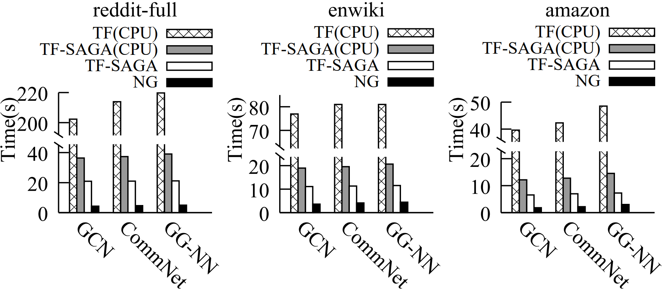
Scaling-up on a Single GPU
Compare with TF(CPU), TF-SAGA(CPU), TF-SAGA on large graphs
TF and DGL run out-of-memory (OOM)
up to 47x speedup vs TF(CPU)
up to 5x speedup vs TF-SAGA
higher density
Avg. epoch time; #layer=2, hidden_size=16 (amazon), 32 (enwiki), 64 (reddit-full)
Notes:
For large graphs that cannot fit into GPU, TensorFlow and DGL run out-of-memory on GPU. So, we compare NeuGraph with TensorFlow CPU version and TF-SAGA.
(click)
It shows that NeuGraph achieves up to 47 times speedup over TF-CPU
(click)
and up to 5 times over TF-SAGA.
We can also see that TF-SAGA-CPU is faster than TF-CPU, because chunks in TF-SAGA-CPU can run concurrently on CPU and achieve a higher CPU utilization.
(click, next slide)

Slide 26
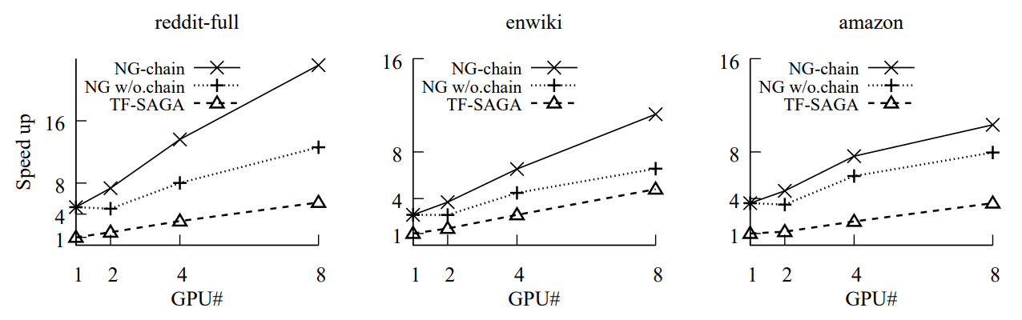
Scaling-out on Multiple GPUs
GCN on three large graphs on different number of GPUs
higher density
Avg. speedup over TF-SAGA-1GPU; #layer=2, hidden_size=16 (amazon), 32 (enwiki), 64 (reddit-full)
Notes:
Finally, we show the scalability over multiple GPUs.
(click)
We found that without chain, NeuGraph gets no speedup for 2 GPUs because of the bandwidth bottleneck in PCIe switch,
(click)
Thanks to the chain-based streaming, NeuGraph gets a nearly linear scalability.
(click, next slide)

Slide 27
Conclusion
NeuGraph: advocate unifying deep learning and graph computing for graph neural networks
Define a new, flexible SAGA-NN model to express GNNs
Fuse graph-related optimizations into deep learning frameworks
Demonstrate NeuGraph achieves efficient and scalable GNN processing
Notes:
Through NeuGraph, we advocate unifying deep learning and graph computing for efficient and scalable GNN processing. NeuGraph represents a critical step in this direction, by showing not only the feasibility, but also the potential of such unification.
(click)
This is accomplished by defining the SAGA-NN model to express GNNs,
(click)
fusing graph optimizations such as graph partition, scheduling and parallelism into deep learning frameworks
(click)
and achieving efficiency and scalability in GNN training.
(click, next slide)

Slide 28
Thank you! Q&A For more information, please visit: https://aka.ms/neugraph
NeuGraph
Notes:
That’s all. Thank you.

Slide 29
Backup

Slide 30

Implementation
Major Components
Python-based Programming Interface
Programming GNNs with SAGA-NN
Dataflow Translator
Translate SAGA-NN to dataflow graph
Streaming Scheduler
Streaming optimizations
Customized Graph Kernels
Kernel optimizations
On top of TensorFlow
SAGA-NN Interface
Dataflow Translator
Streaming Scheduler
Graph Kernels
Existing Dataflow System
Notes:
In our implementation,
(click)
We implement SAGA-NN as a python-based programming interface for programming GNN applications,
(click)
and a graph-aware dataflow translator to generate chunk-based dataflow graph.
(click)
Then, the streaming and kernel optimizations are applied for efficiency.
(click)
Finally, for compatibility, NeuGraph is designed on top of existing dataflow systems and implemented on TensorFlow, which can directly run the generated dataflow graph.
(click, next slide)

